Slide 1
Conceptual design and realization of a graphical tool for determining the test coverage of digital circuit diagrams
Master-Thesis presentation by
Razvan Matis
Matr. Nr.: 2403005

Slide 2
Content
Fundamentals
Requirements
Conceptual design
Realization
Test coverage determination
Application overview
Live demonstration of the created tool

Slide 3
1. Fundamentals
ODB++ format
PCB Investigator
JTAG interface
Boundary scan tests
BSDL (Boundary scan description language)
SVF file format
Model-View-ViewModel design pattern
GRPC communication protocol

Slide 4
2. Requirements
Open ODB++ project files
Different object related actions
Settings handling
Export / Import mechanism to / from JSON formatted files
Determination of different test coverage values
Creation of SVF files
Usage of in house libraries
LogPanel
SettingsPanel
SvfPlayer

Slide 5
3. Conceptual design
Used language: C#
Used IDE: Visual Studio 2019 Community Edition
Patterns and frameworks used
Dependency injection
Material design
Factory pattern
Strategy pattern
Command pattern

Slide 6
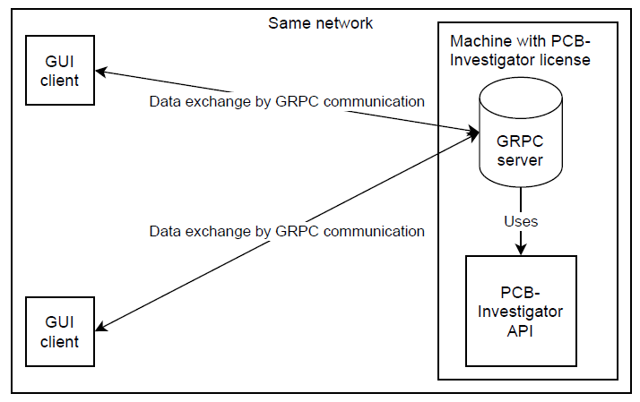
3. Conceptual design
There was the decision
made of using two separate
projects of interest which
are communicating by
GRPC requests

Slide 7

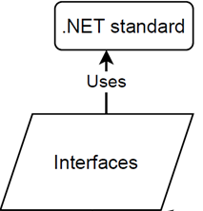




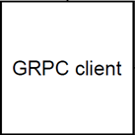
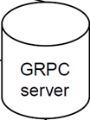
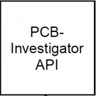

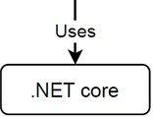
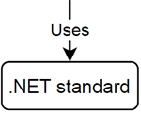
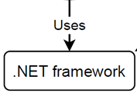

3. Conceptual design
The used target frameworks
differ in dependency on the
realized project

Slide 8
3. Conceptual design
The PCB Investigator API
provided a complex class
diagram for all objects of
interest

Slide 9
3. Conceptual design
I transformed the class
diagram in a easier one
by having available
all information of
interest

Slide 10
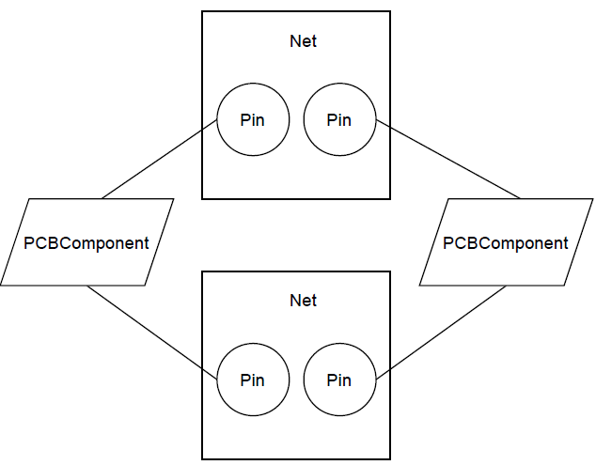
3. Conceptual design
So it was ensured to be able to project
all connection possibilities which could
physically occur

Slide 11
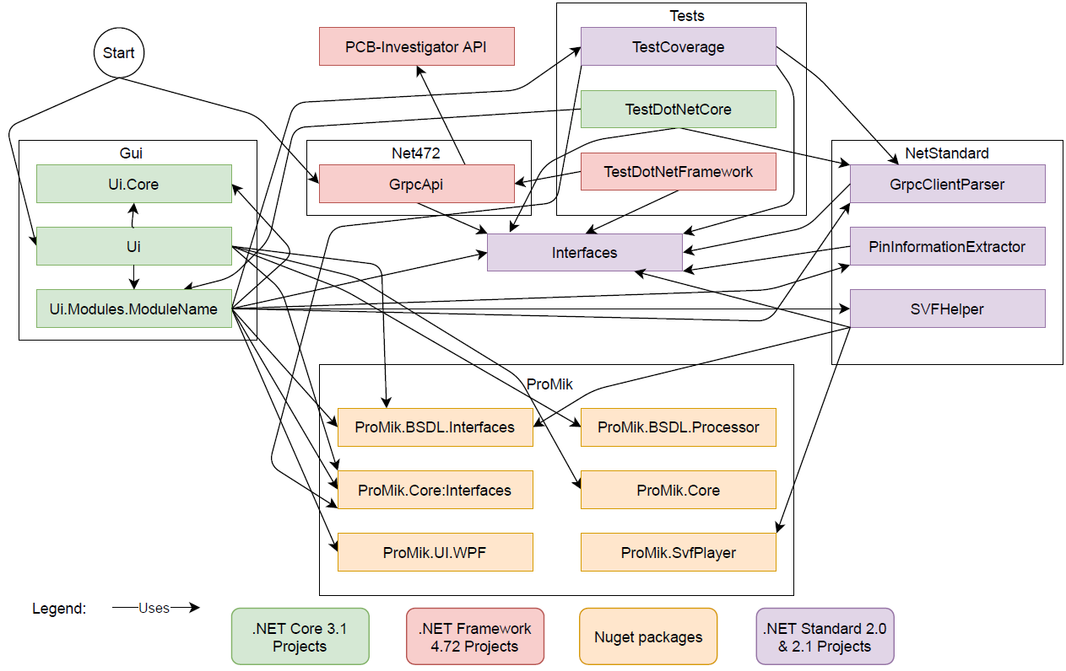
4. Realization
There were many
projects created
to make sure for
being able to use
them as
separately as
possible

Slide 12
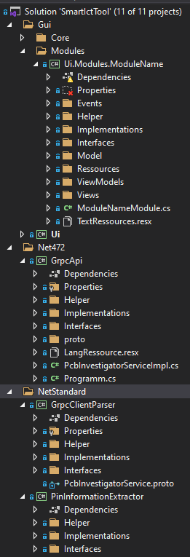
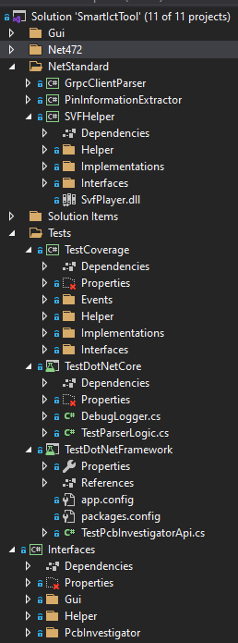
4. Realization
The solution itself was
created following a highly
structured way for making
sure to use a loose coupling

Slide 13



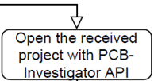

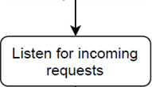
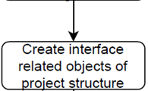


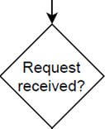
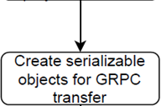
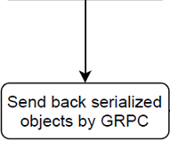
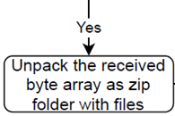

4. Realization
The GRPC program schedule
of the GRPC stand alone
server looks as the following:

Slide 14
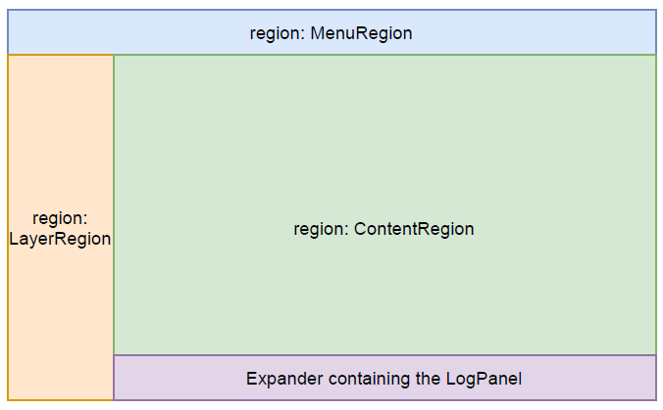
4. Realization
The whole application is
structured in the following
way by using regions of the
PRISM framework

Slide 15
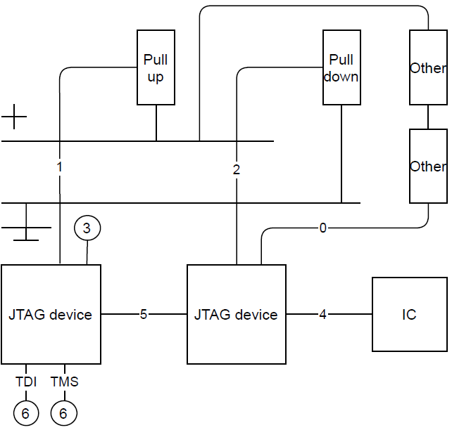
5. Test coverage determination
0. Connection to an unknown
component
1. Connection to a pull up resistor
2. Connection to a pull down resistor
3. Connection to anything
4. Connection to another IC
5. Connection to another JTAG device
6. A pin which is directly a JTAG
control pin (TDI, TDO, TMS, TCK)

Slide 16
5. Test coverage determination
Base = the amount of total pins of all JTAG devices
JTAG test coverage = amount of total JTAG devices / Base
Pull up test coverage = amount of total pull up resistor nets / Base
Pull down test coverage = amount of total pull down resistor nets / Base
Others test coverage = amount of other connected component nets / Base

Slide 17

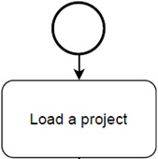


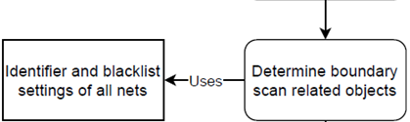
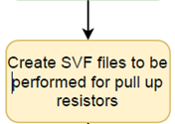

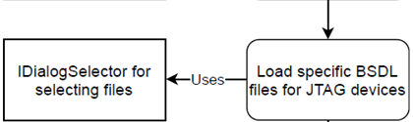
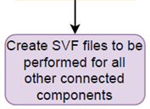

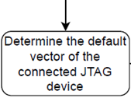

5. Test coverage determination
In dependency on the BSDL file
then the SVF files could be
generated for all pull up,
pull down resistors
and unknown
components

Slide 18


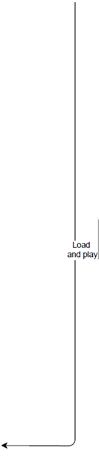





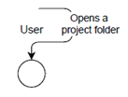
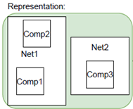
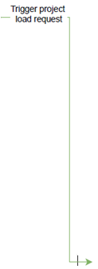
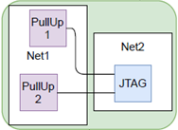
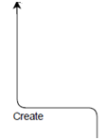

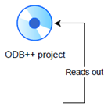





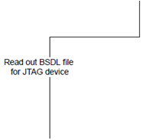














6. Application overview
There was
definitely provided
a powerfull
graphical tool for
being able to
determine test
coverage values
and create SVF
files

Slide 19
7. Live demonstration of the created tool
Now the software itself should be showed live…
Please enjoy!!!

Slide 20
8. Questions
Are there any open questions regarding that project?

